Slide 1
Group 4
Machine learning,Robots and Sensor Networks Summer School
Group projects ideas

Slide 2
CONTENTS
Backgrounds
Our plan
Hardware
Software
Integration & Expectation

Slide 3

Brief Video

Slide 4
01
Backgrounds

Slide 5
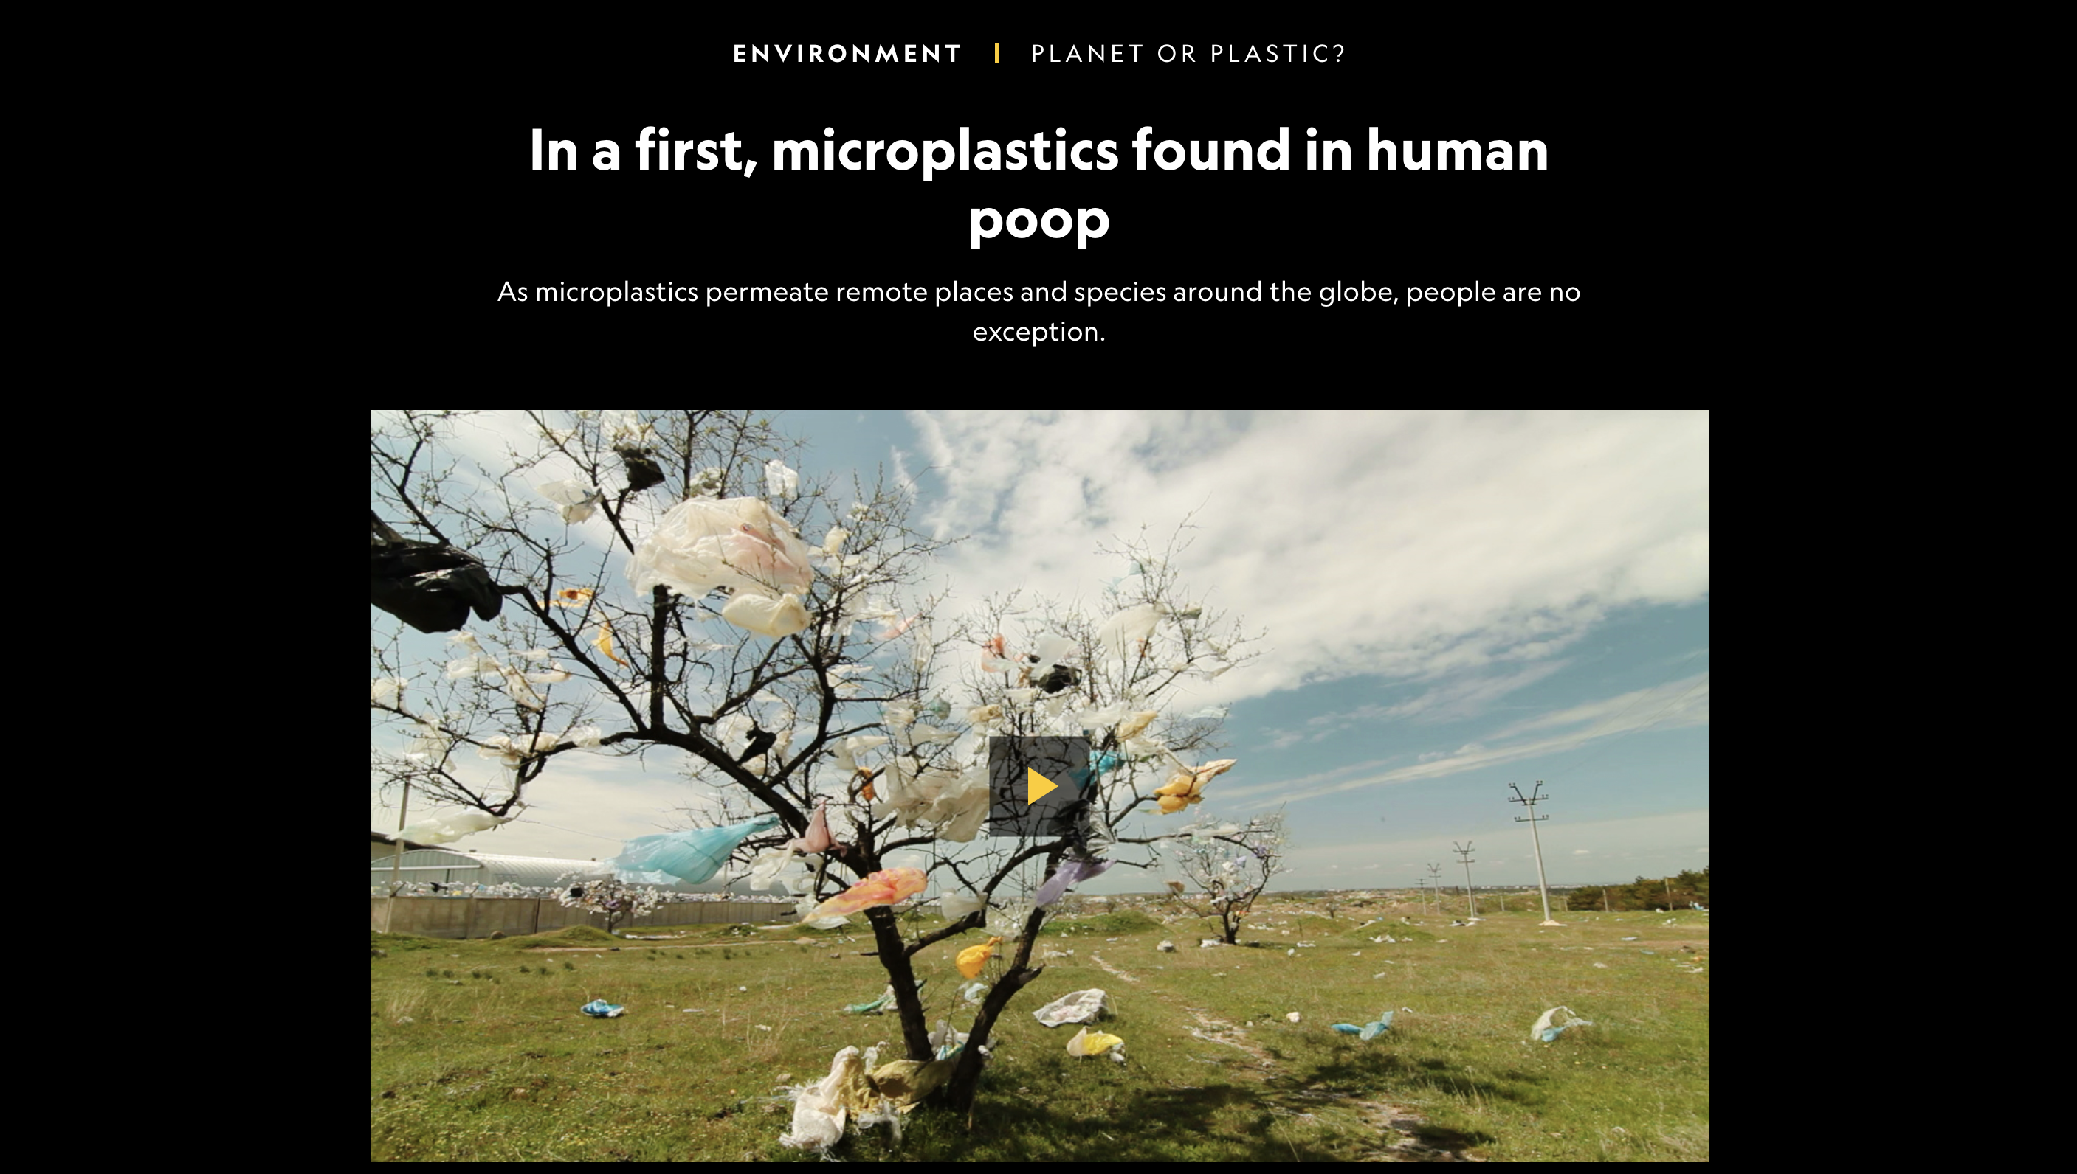
Problems

Slide 6
Garbage Classification

Slide 7
Backgrounds of the selected topic
Garbage classification is a reform of the traditional way of garbage collection and disposal. Faced with the increasing garbage production and the deterioration of environmental conditions, how to realize the maximum utilization of garbage resources, reduce the amount of garbage disposal and improve the quality of living environment through garbage classification management is one of the urgent problems that all countries around the world pay great attention to.

Slide 8
02
Our Plan

Slide 9
Sorting garbage
Manual waste sorting for recycling

Slide 10
Sketch map
Classification
Picker
Various kinds of garbage

Slide 11
03
Hardware
Mechanical arm
Realsense

Slide 12
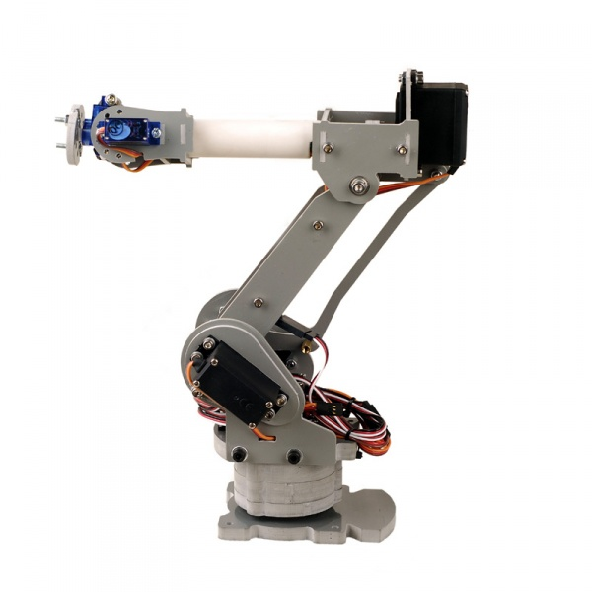
Mechanical arm
Name：SainSmart 6-Axis Desktop Robotic Arm
Characteristics：
1、Simulate real palletizing robot arm structure
2、PVC material, CNC processing
3、Adopts MG996 55g metal gear servo 4pcs
4、Active joint bearing connection

Slide 13
Mechanical arm-Parameter
MG996 Servo
Size: 40.7*19.7*42.9mm
Working torque: 9.4-13kg/cm
Respond rotation speed: 53-62R/M
Working temperature: -30~+60°C
Dead zone: 5us
Plug: JR, Futaba
Rotation angle: 180 degree
Analog servo
Working current: 100mA
Working voltage: 5-7.2V
Metal gear, coreless motor, two ball bearing
Operation speed: 0.17s/60degree(4.8V); 0.14S/60degree(6.0V)
SG90 servo
Size: 23*12.2*29mm
Weight: 9g
Working torque: 1.6kg/cm
Respond rotation speed: 0.12-0.13s/60degree
Working temperature: -30~+60 C
Dead zone: 5ms
Plug: JR, Futaba
Rotation angle: 180 degree
Analog servo
Working current: 100mA
Working voltage: 3.5-6V
Metal gear
.

Slide 14
Mechanical arm
This is the robot arm we are going to implement in our project. As you can see, it has 6 axes, which enable it to simulate every movement like the real robotic arm. We can program it to move forward and back, up and down, and side to side.
Compatible with the Arduino, it simulates a real palletizing robot arm structure with durable PVC material and a host of servos. The beauty of this arm is that it comes fully assembled, so little setup is required aside from the actual programming.

Slide 15
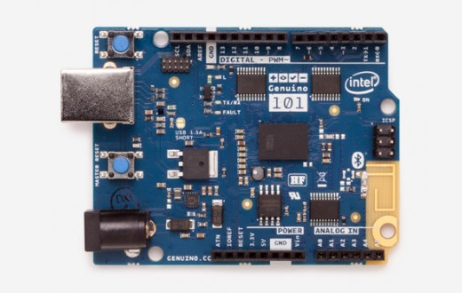
Mechanical arm-Development Edition
Name：Arduino / Genuino 101
Brief Introduction：The Arduino/Genuino 101 is a learning and development board which contains the Intel® Curie™ Module, designed to integrate the core's low power-consumption and high performance with the Arduino's ease-of-use. The 101 adds Bluetooth Low Energy capabilities and has an on-board 6-axis accelerometer/gyroscope, providing exciting opportunities for building creative projects in the connected world.

Slide 16
Mechanical arm-Development Edition
The module contains two tiny cores, an x86 (Quark) and a 32-bit ARC architecture core, both clocked at 32MHz. The Intel toolchain compiles your Arduino sketches optimally across both cores to accomplish the most demanding tasks. The Real-Time Operating Systems (RTOS) and framework developed by Intel is open sourced. The Arduino core communicates with the RTOS via static mailboxes to accomplish a predefined list of tasks (interface with PC using USB, program the sketch into flash, expose Bluetooth LE functionality to sketch, perform PWM). The RTOS for Intel Curie is still under development and new functions and features will be released in the near future. The 101 comes with 14 digital input/output pins (of which 4 can be used as PWM outputs), 6 analog inputs, a USB connector for serial communication and sketch upload, a power jack, an ICSP header with SPI signals and I2C dedicated pins. The board operating voltage and I/O is 3.3V but all pins are protected against 5V overvoltage. The Arduino 101 and the Genuino 101 boards have been designed in collaboration with Intel®.

Slide 17
Mechanical arm-Development Edition Parameter
Microcontroller Intel Curie
Operating Voltage 3.3V (5V tolerant I/O)
Input Voltage (recommended) 7-12V
Input Voltage (limit) 7-17V
Digital I/O Pins 14 (of which 4 provide PWM output)
PWM Digital I/O Pins 4
Analog Input Pins 6
DC Current per I/O Pin 20 mA
Flash Memory 196 kB
SRAM 24 kB
Clock Speed 32MHz
LED_BUILTIN 13
Features Bluetooth LE, 6-axis accelerometer/gyro
Length 68.6 mm
Width 53.4 mm
Weight 34 gr.

Slide 18
Mechanical arm-Development Edition
This is the development board that we are going to use with the robot arm. The Arduino Genuino 101 is a learning and development board which contains the Intel® Curie™ Module, designed to integrate the core's low power-consumption and high performance. The 101 adds Bluetooth Low Energy capabilities and has an on-board 6-axis accelerometer/gyroscope, providing exciting opportunities for building creative projects in the connected world. The module contains two tiny cores, 14 digital input/output pins, 6 analog inputs, a USB connector for serial communication and sketch upload, a power jack, an ICSP header with SPI signals and I2C dedicated pins. By using the Arduino Software (IDE), we can program this board. So that we can control the robot arm via command, or setting a trigger and many other ways.

Slide 19
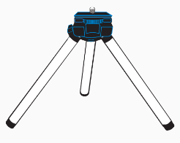
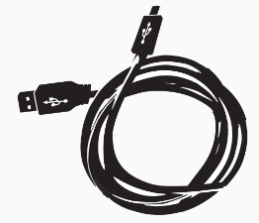
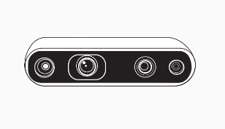
Realsense
What do we have?
Intel RealSense Depth Camera
Tripod
USB-C* Cable

Slide 20
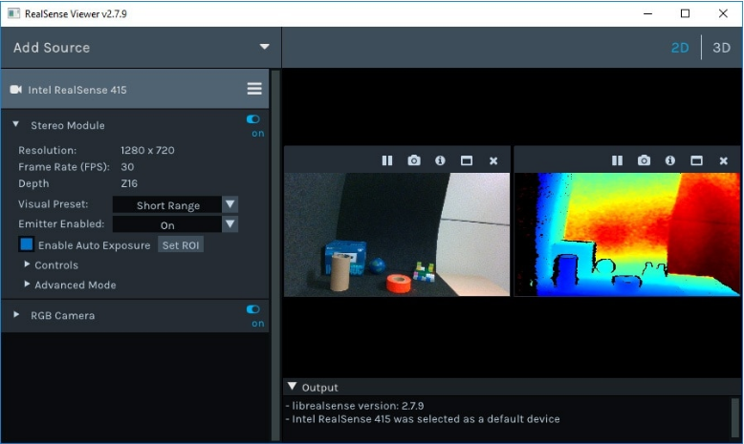
Realsense-Intel RealSense viewer
a RGB stream
a depth stream

Slide 21
Realsense
What can we do with it?

Slide 22
04
Software
Object Detection

Slide 23
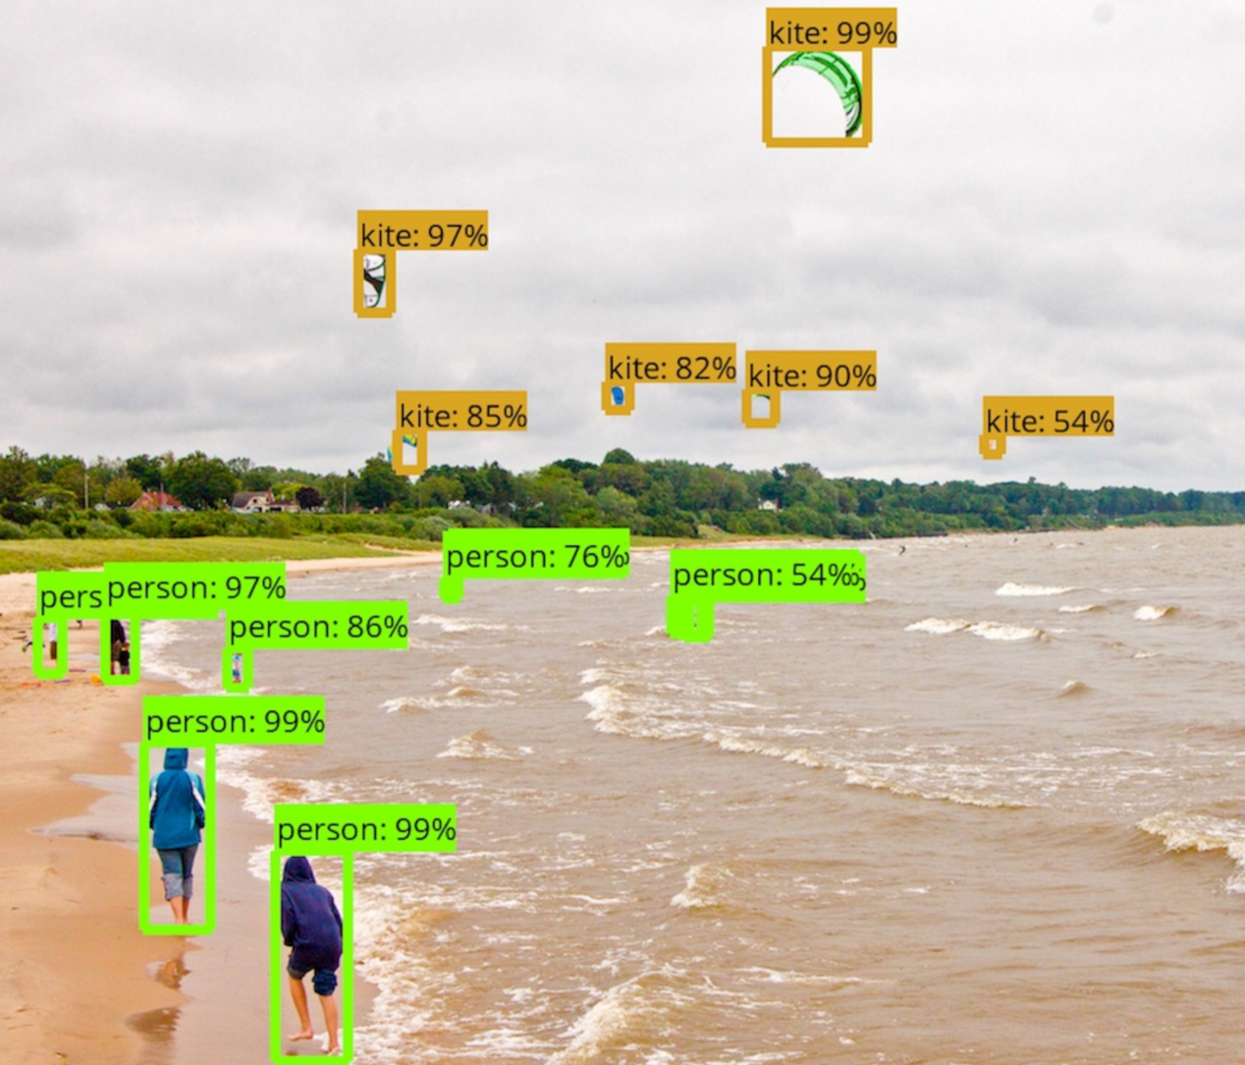
Object Detection
Training time:
inputs -> preprocess -> predict -> loss -> outputs
Evaluation time:
inputs -> preprocess -> predict -> postprocess -> outputs

Slide 24
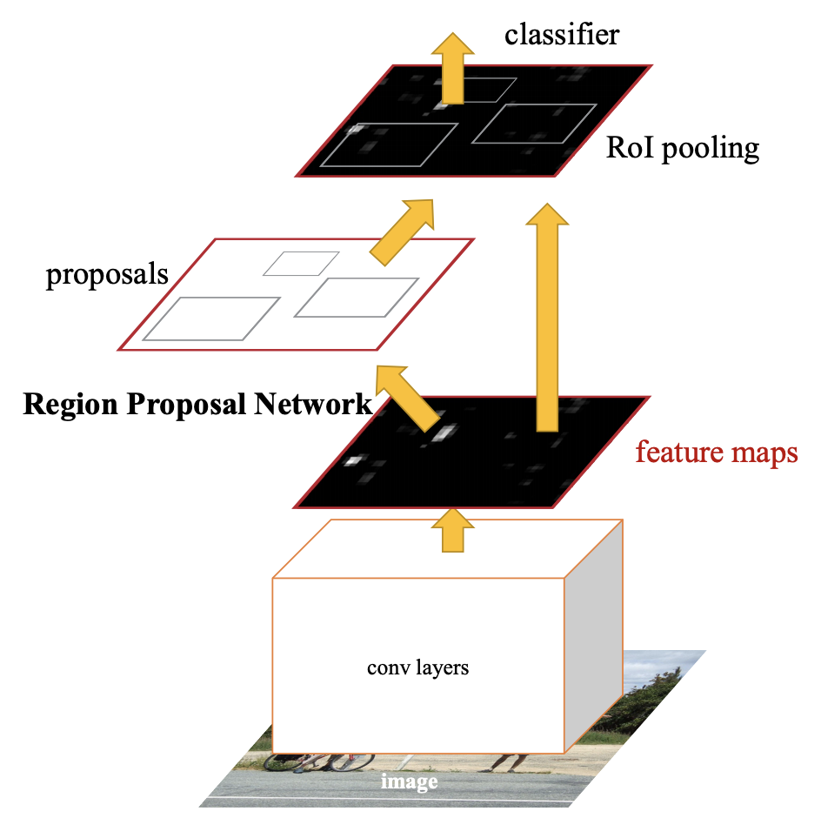
Object Detection
Faster R-CNN

Slide 25
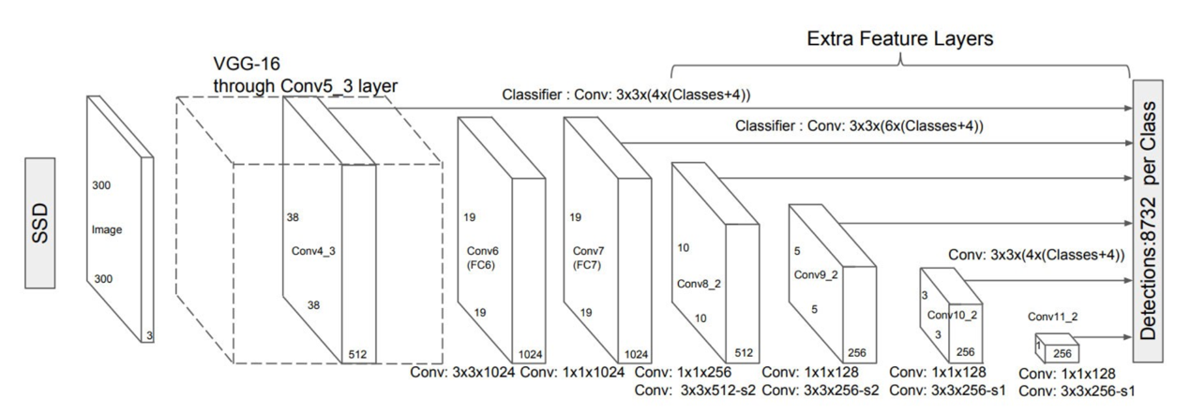
Object Detection
SSD

Slide 26
Object Detection
Training custom Object-detection classifier

Slide 27
05
Integration

Slide 28
Integration-Hardware&Software
Camera Side：
Input: None
Output: image & depth information
Classification Side：
Input: image & depth information
Output: the coordinate, width and class of the classified garbage
Robotic Arm Side：
Input: the coordinate, width and class of the classified garbage
Output: grabbing the classified garbage and placing it in a specific area

Slide 29
06
Expectations

Slide 30
Expectations
Specification
Camera & Classification Side:
Should be able to
•Get pictures of the garbage to be classified
•Detect garbage in image as well as classify it
•Provide the coordinate and width of the garbage
Robotic Arm Side:
Should be able to
•Move arm to the coordinate of the garbage
•Grab the garbage steadily
•Move the garbage to specific location

Slide 31
Expectations
As a whole
With garbage placed in a fixed area, as a whole, the system should be able to
•Detect garbage in the image
•Classify the class of the garbage
•Get the coordinate and width of the garbage
•Grab and move the garbage to an expected area

Slide 32
07
Team members

Slide 33
Team members
01
Zhang Hanqing
year 3
Remote Sensing and Photogrammetry
02
Xu Sixiao
year 2
Computer Science and Technology
03
Fu Shuhao
year 2
Computer Science and Engineering
04
Zhang Haoran
year 3
Optoelectronic Informatian Science and Engineering
05
Duan Yuxin
year 2
Software Engineering
06
Wei Wenlan
year 2
Electronic Engineering

Slide 34
Thanks!
TAHNK YOU FOR WATCHING
Group 4

